Slide 1


CACIB
TECHTALK
Notes:
Proceed to next slide

Slide 2
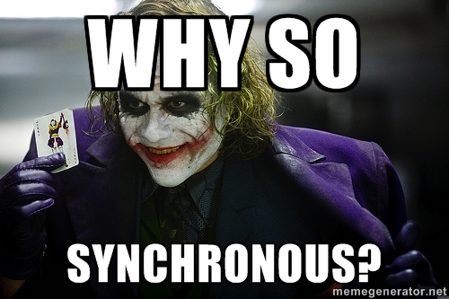
we tend to think…
SYNCHRONOUSLY
Notes:
Left to right
Top to bottom
Block of code

Slide 3

but mostly work… ASYNCHRONOUSLY
Handling user inputs
Animations
Websockets
API calls
Notes:
But when it comes to front-end devt

Slide 4
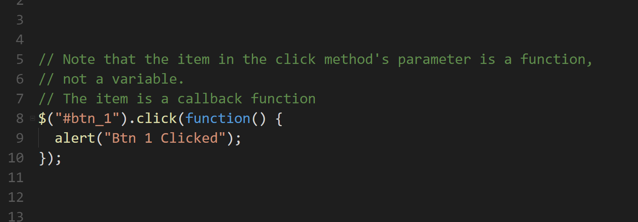
Notes:
When we work with async, we work usually callbacks
Allow us to do something during or after an async event

Slide 5

Notes:
But there’s one problem with callbacks
Whether we like it or not, we are sometimes forced to do this

Slide 6
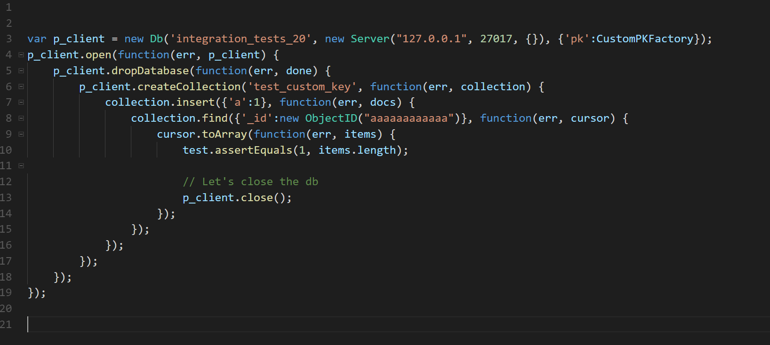

Slide 7
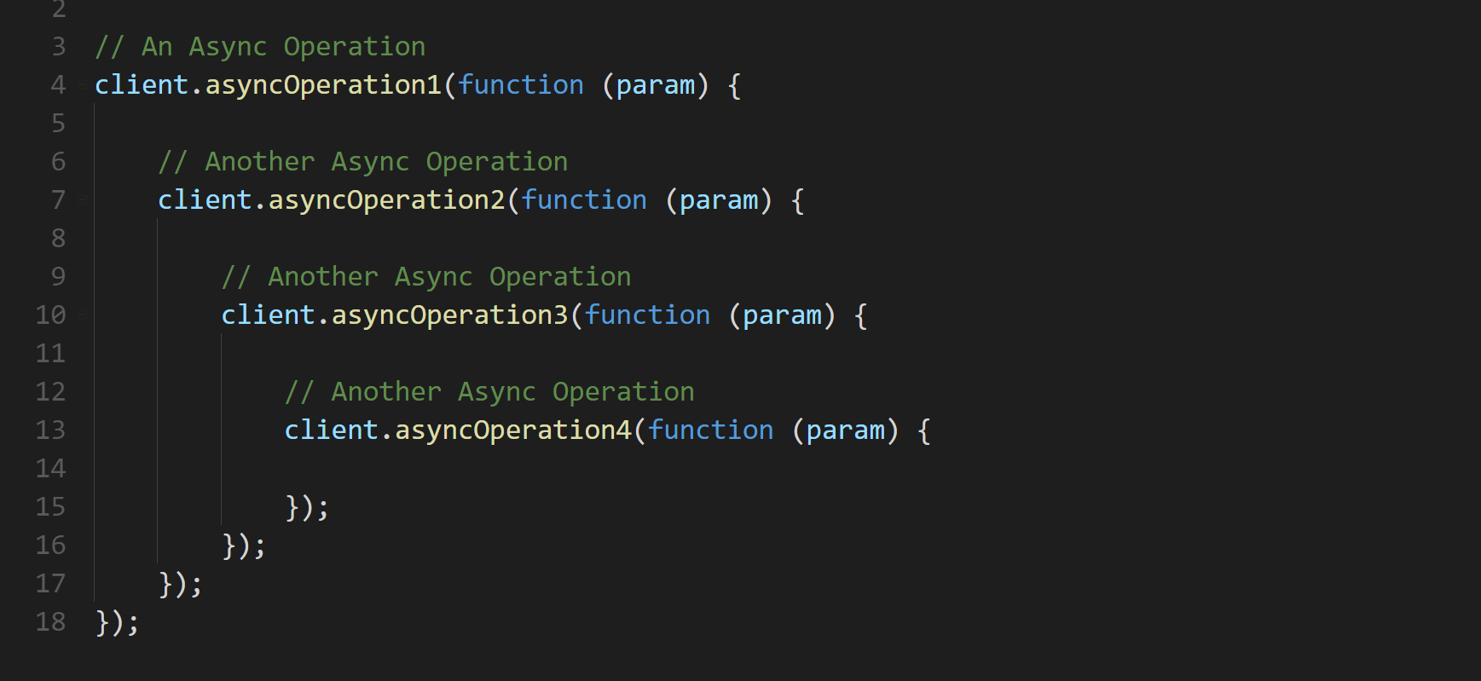
Notes:
Async after async operations
There’s got to be a better way, a more elegant way to handle async callbacks
And the answer for that is called promises

Slide 8
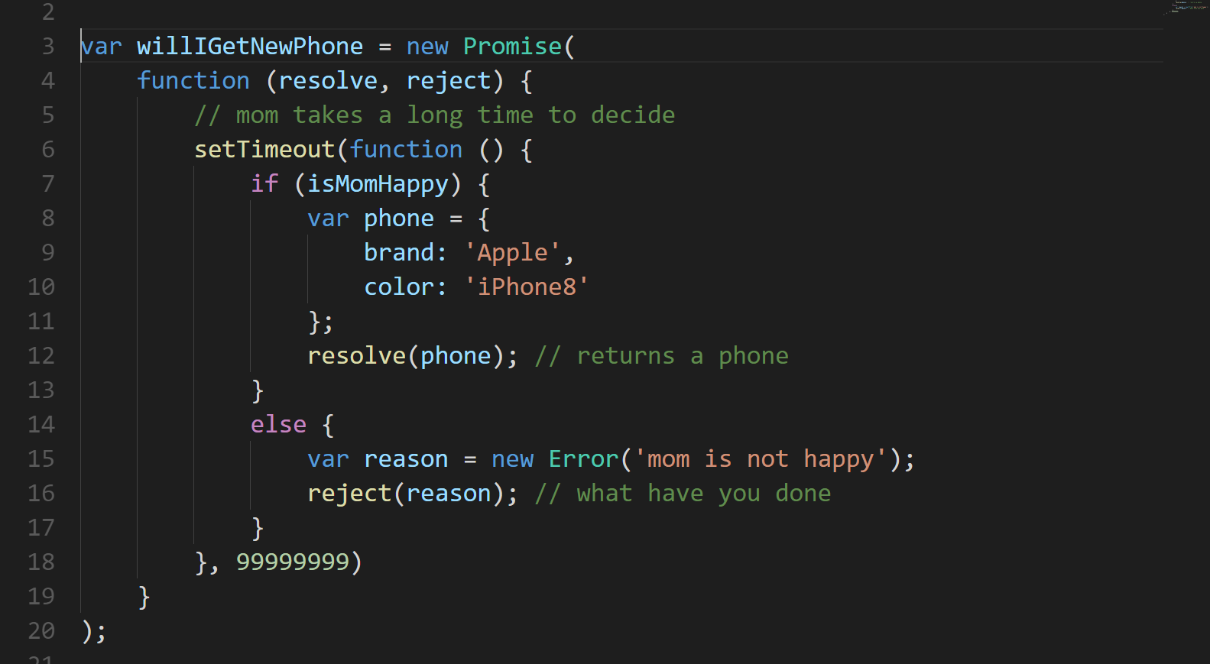
Notes:
The Promise object represents the eventual completion (or failure) of an asynchronous operation, and its resulting value

Slide 9
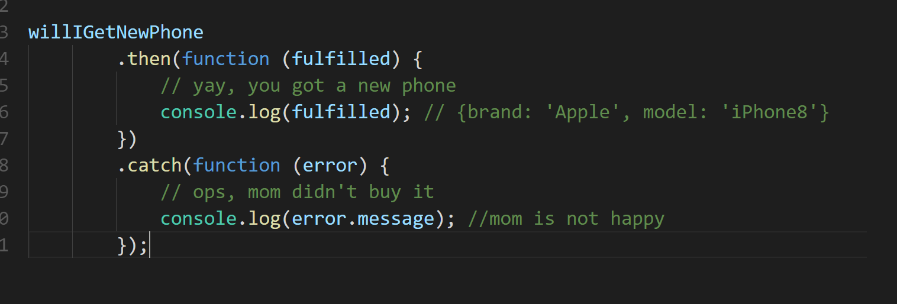

Slide 10
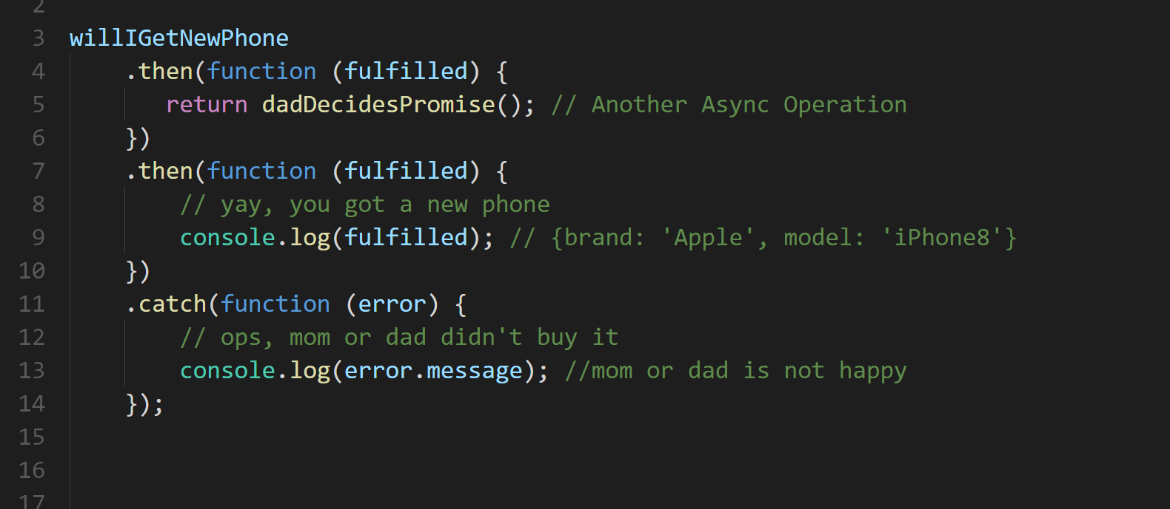

Slide 11
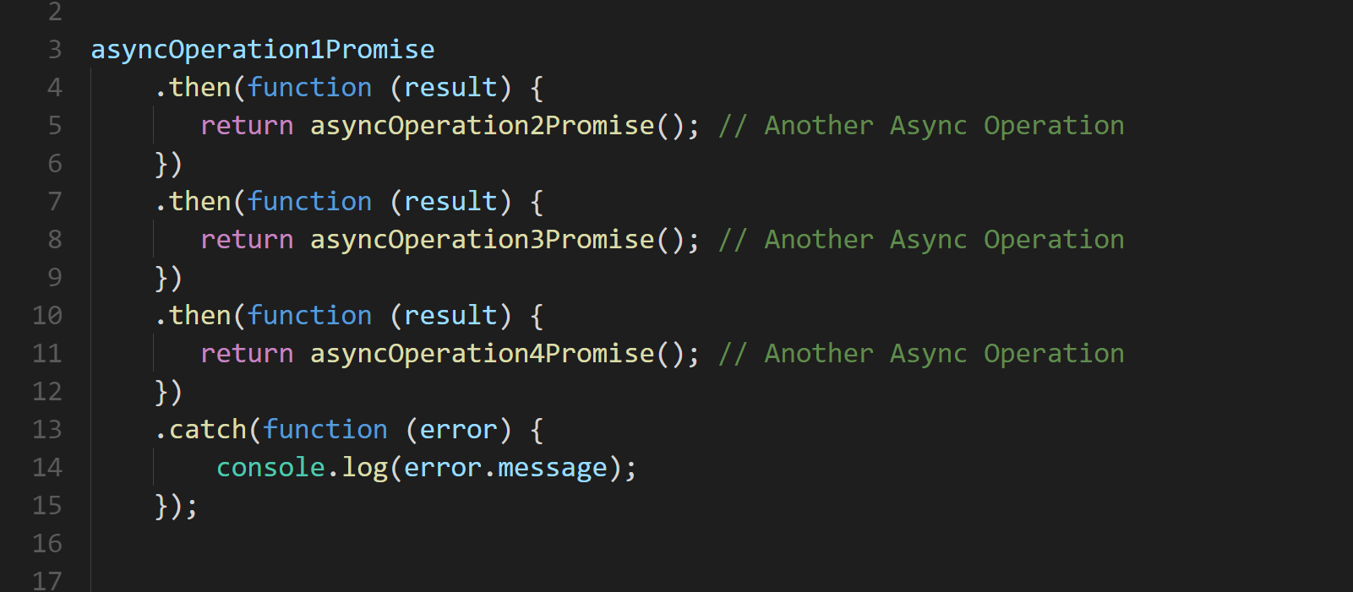
Notes:
Promises help us to better handle async

Slide 12


Notes:
Retry a promise
Cancel a promise
One promise multiple values?

Slide 13
Angular and RxJS WE WANT TO BREAK PROMISES
Rogeross Beraña
RFI Software Engineer
CACIB TECHTALK

Slide 14

Angular
a JavaScript framework that helps developers build applications
https://angular.io/
Notes:
Notice I don’t put 2 or 4

Slide 15

Reactive Extensions for Javascript
set of tools allowing us to operate on sequences of data (usually asynchronous)
http://reactivex.io/

Slide 16
Reactive Extensions for JAVASCRIPT
.NET
JAVA
SWIFT
http://reactivex.io/
KOTLIN
SCALA
Notes:
Then history:
Rxjs is more than 9 yrs old first release 2009 for .NET
Created by Matt Podwysocki
As a part of an internal Microsoft project
Then Java open source github

Slide 17






http://reactivex.io/
Notes:
Some of the users now
Community drive project spearheaded by contributors from Microsoft, Google and Netflix

Slide 18
OBSERVABLES
http://reactivex.io/

Slide 19
PROMISE
An operation that hasn’t completed yet, but is expected in the future
Used with async/deferred operations
Can be hooked to a callback
PROMISES
and
OBSERVABLES

Slide 20
OBSERVABLES
An object that can be subscribed to by other objects (observers)
Can return multiple values over time – an async data stream
Event based
PROMISES
and
OBSERVABLES

Slide 21
PROMISES OVERVIEW
CALL
I’M A DATA
Angular Service
PROMISE
Angular Component

Slide 22
OBSERVABLES OVERVIEW
I’M A DATA
I’M A DATA
I’M A DATA
SUBSCRIBE
OBSERVABLE
OBSERVER
Angular Service
Angular Component

Slide 23
OBSERVABLES OVERVIEW
DATA
DATA
DATA
SUBSCRIBE
OBSERVABLE
OBSERVER
Angular Service
Angular Component

Slide 24
PROMISES and OBSERVABLES overview
PROMISES
Returns a single value
Cannot cancel
Natively supported in browsers
OBSERVABLES
Can return multiple values overtime
Can cancel
Support standard array functions (map, filter, reduce, etc.)
Relies on library such as RxJS (for now)

Slide 25
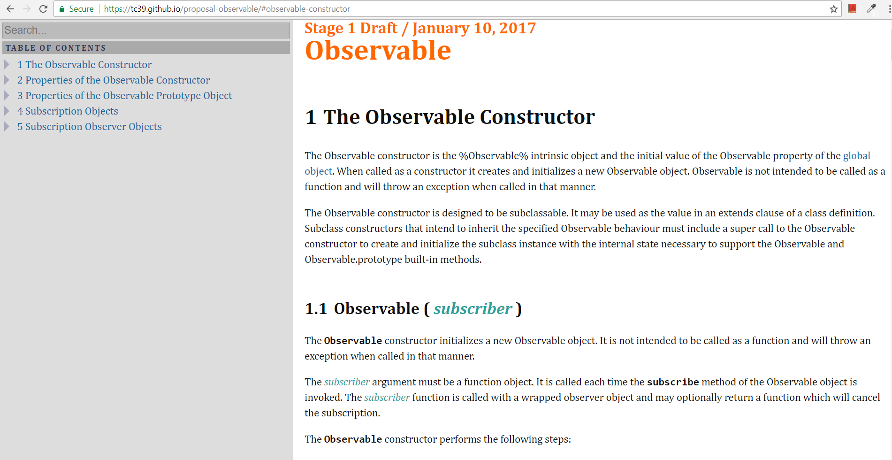
Observable Stage 1 Draft
https://tc39.github.io/proposal-observable

Slide 26
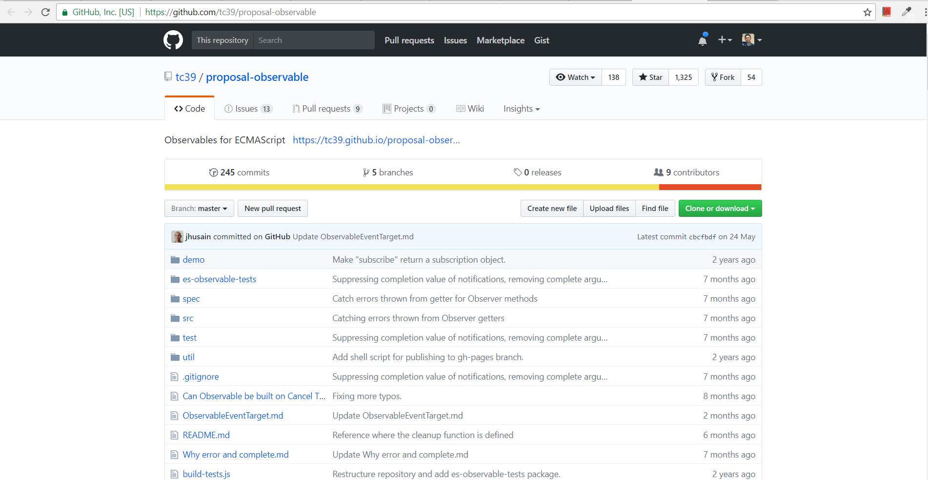
Observable Github Repo
https://github.com/tc39/proposal-observable

Slide 27
Angular and RxJS MAKE ASYNC GREAT AGAIN
CACIB TECHTALK

Slide 28
Rx IMPORTANT CONCEPTS
OBSERVABLE
SUBSCRIPTION
OBSERVER
next( )
error( )
complete( )

Slide 29
Rx IMPORTANT CONCEPTS
OBSERVABLE
OBSERVER
next( )
error( )
complete( )
OBSERVABLE

Slide 30
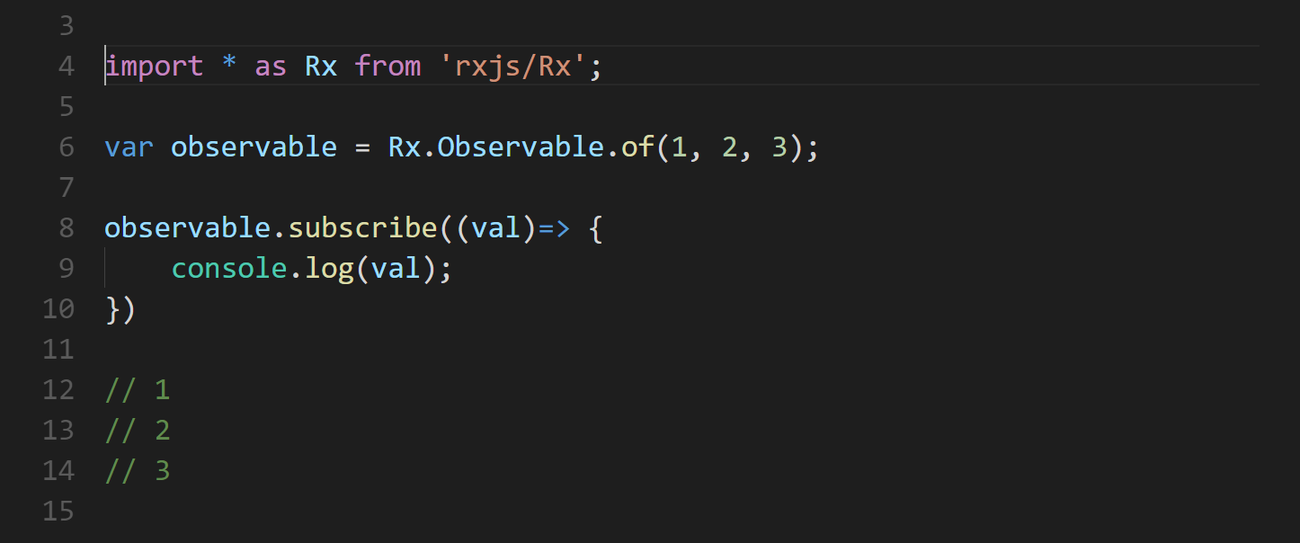

Slide 31
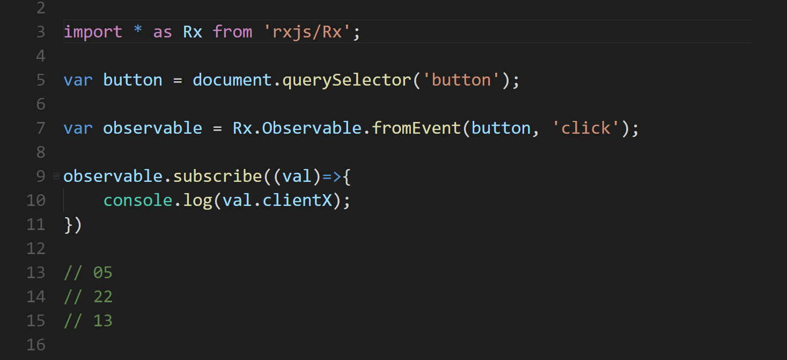

Slide 32
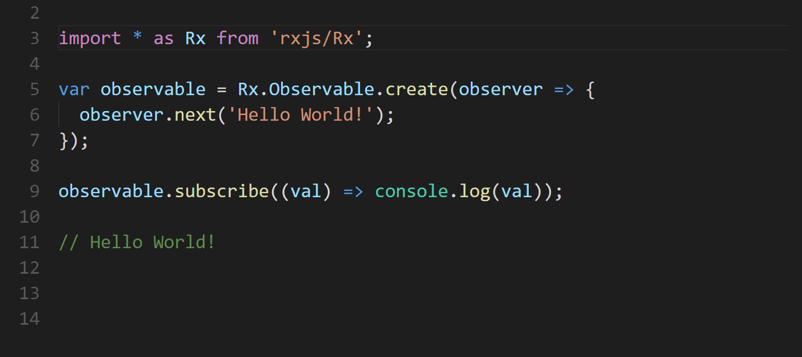

Slide 33
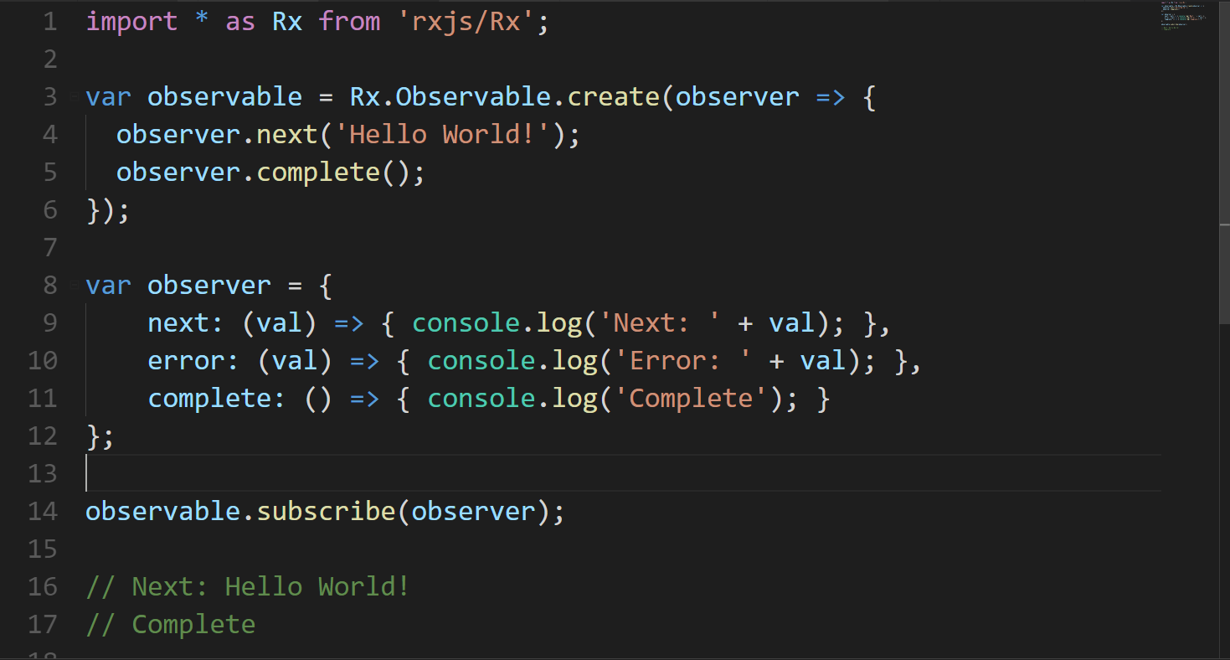

Slide 34
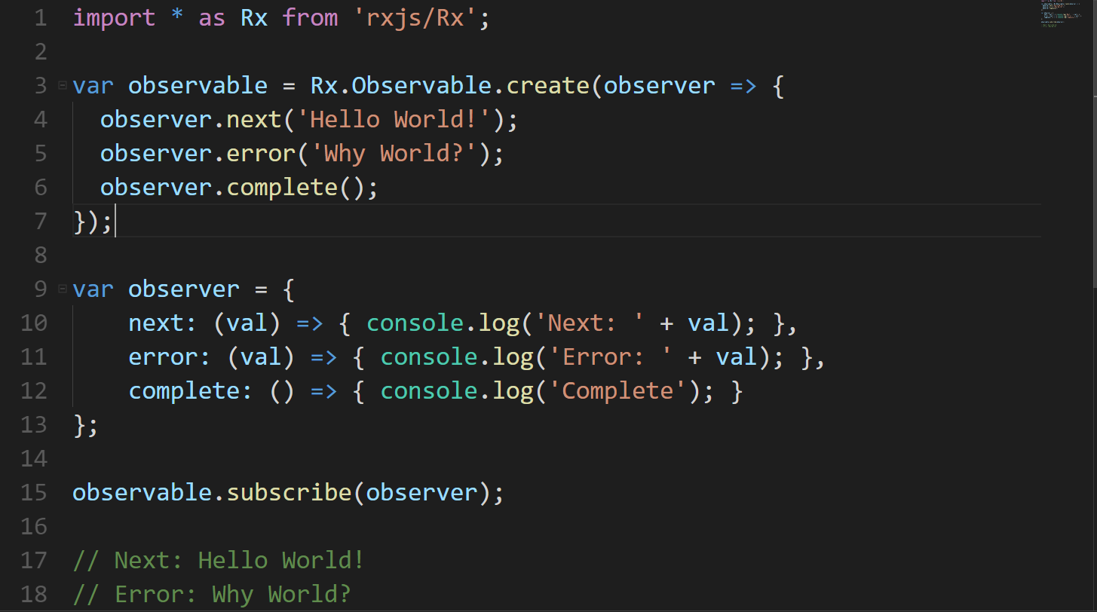

Slide 35
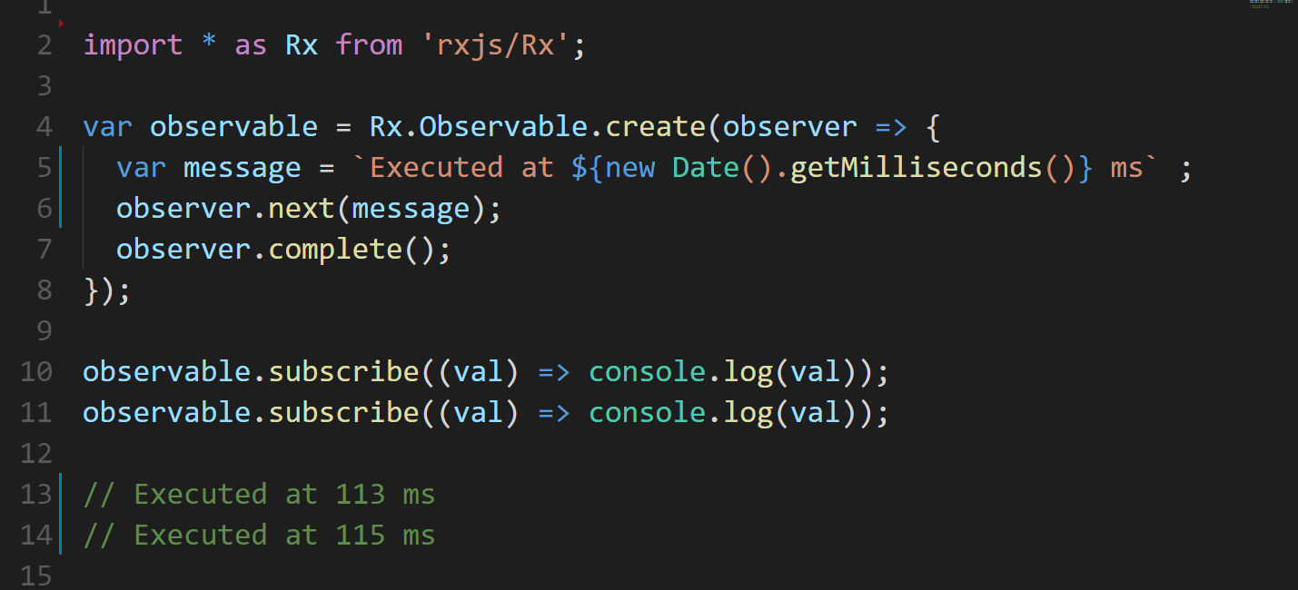
COLD OBSERVABLE
Notes:
Cold observable
Async process executed during subscribe

Slide 36
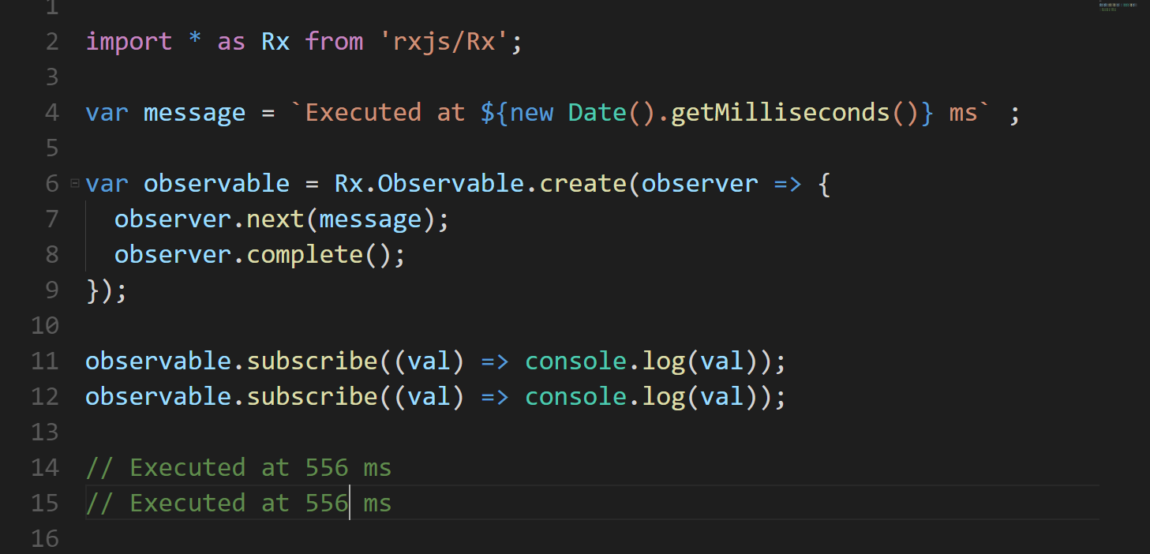
HOT OBSERVABLE
Notes:
Hot observable

Slide 37
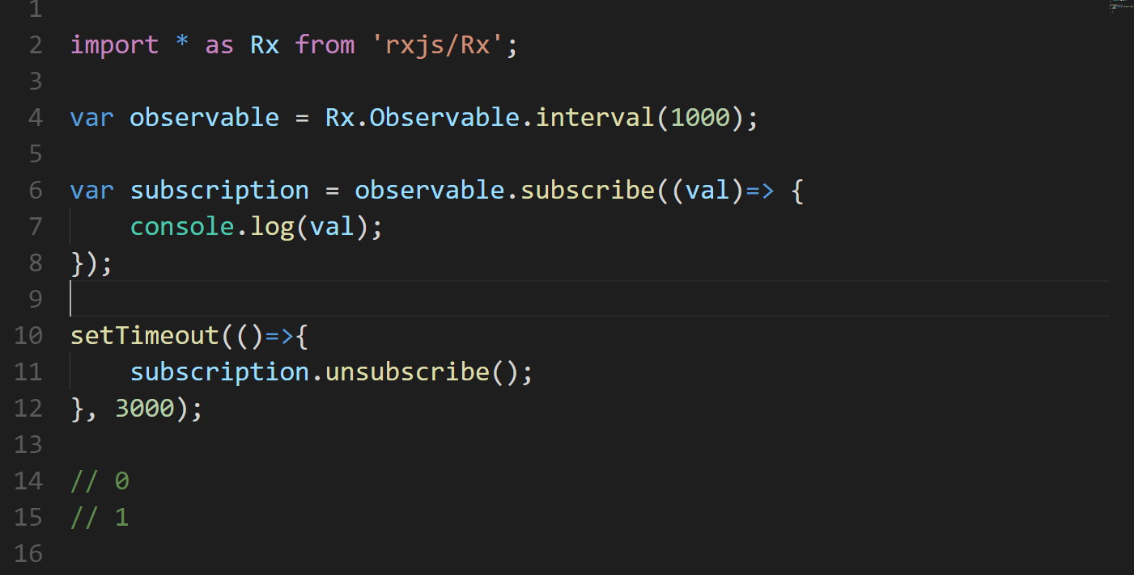
SUBSCRIPTION
Notes:
Hot observable

Slide 38
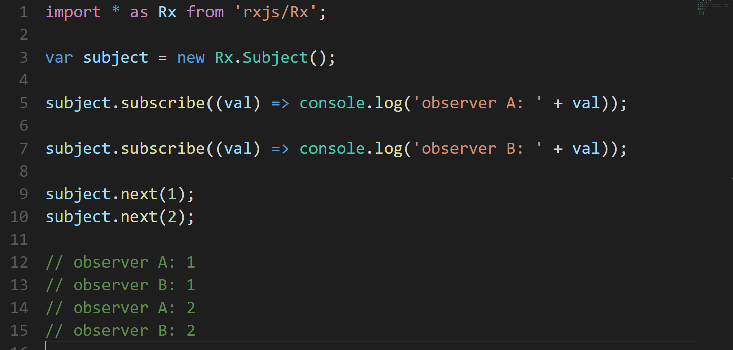
SUBJECT
Notes:
Hot observable

Slide 39
OPERATORS
CREATION
from
interval
of
timer
COMBINATION
combineLatest
concat
merge
race
startWith
withLatestFrom
zip
MATH
count
max
min
reduce

Slide 40
OPERATORS
FILTERING
debounce
distinct
elementAt
filter
find
first
sample
skip
take
throttle
TRANSFORMATION
buffer
concatMap
map
mergeMap
pairwise
pluck
repeat
scan
switchMap
switchMapTo
UTILITY
delay
delayWhen

Slide 41
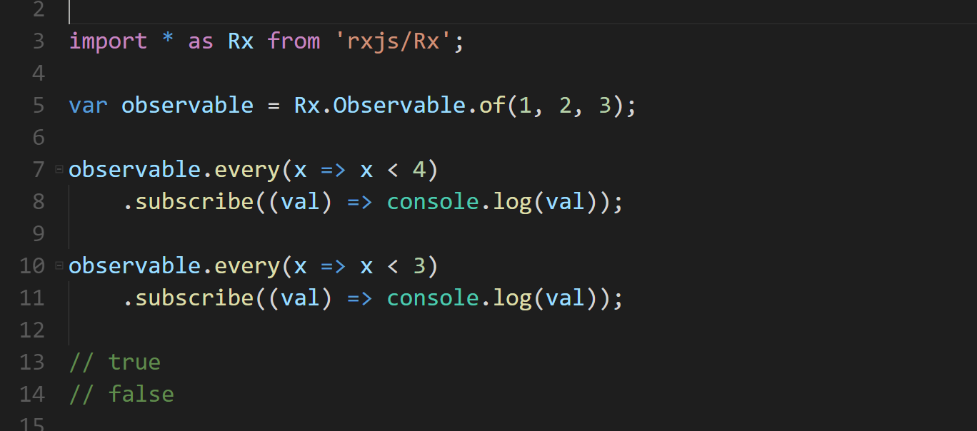
EVERY OPERATOR

Slide 42
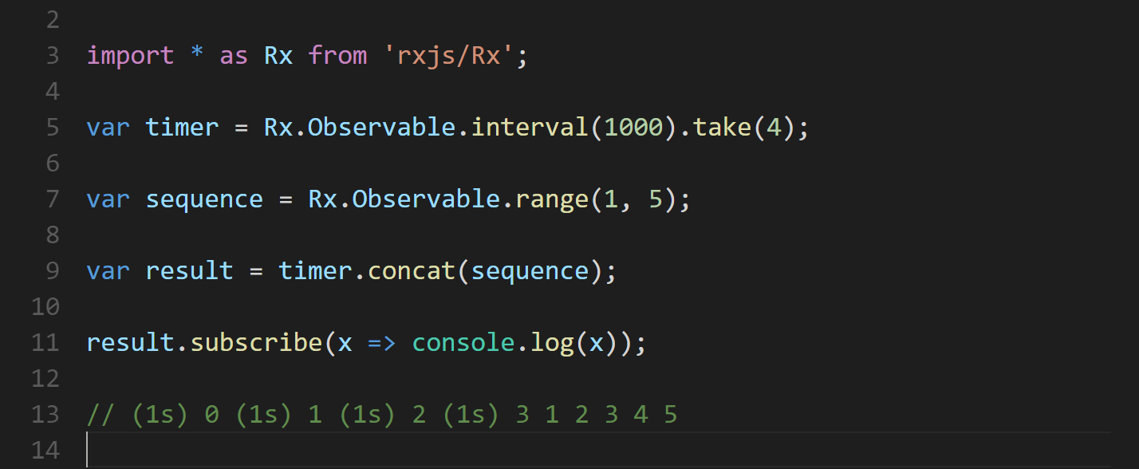
TAKE & CONCAT OPERATOR

Slide 43
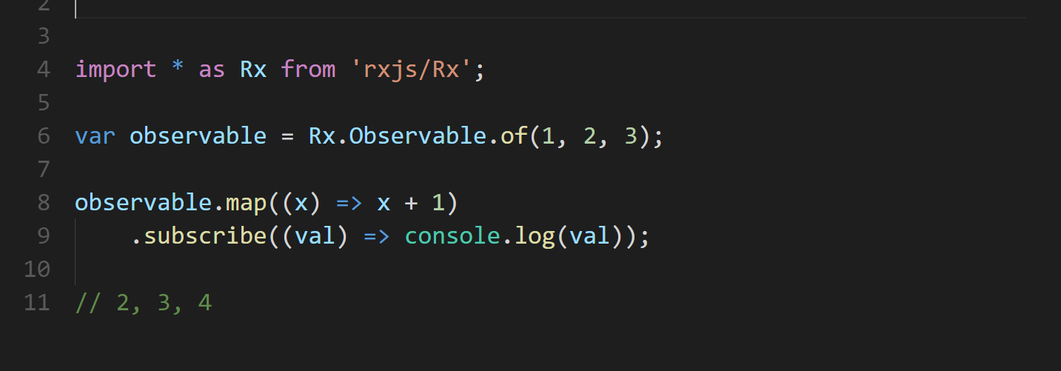
MAP OPERATOR

Slide 44
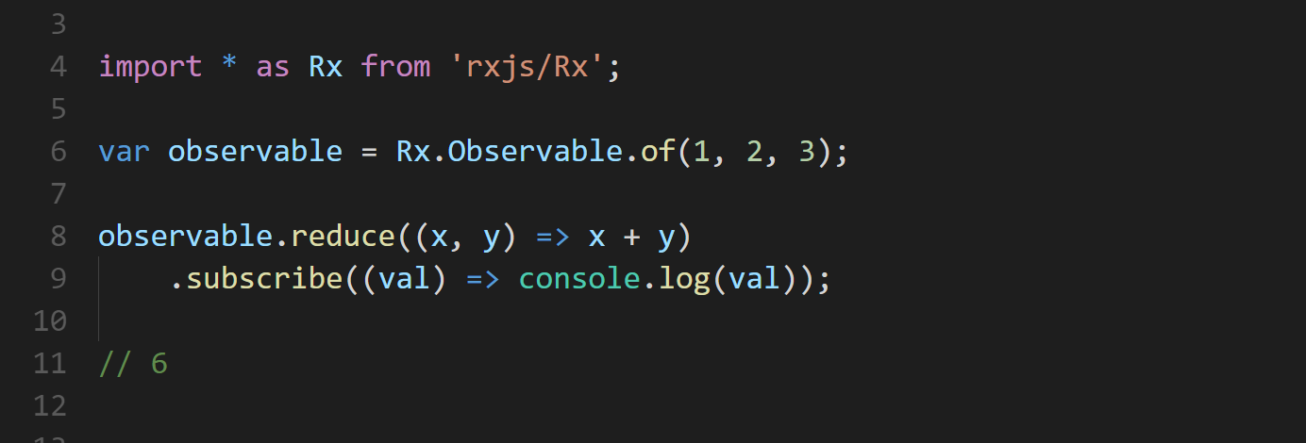
REDUCE OPERATOR
Notes:
Compare to scan

Slide 45
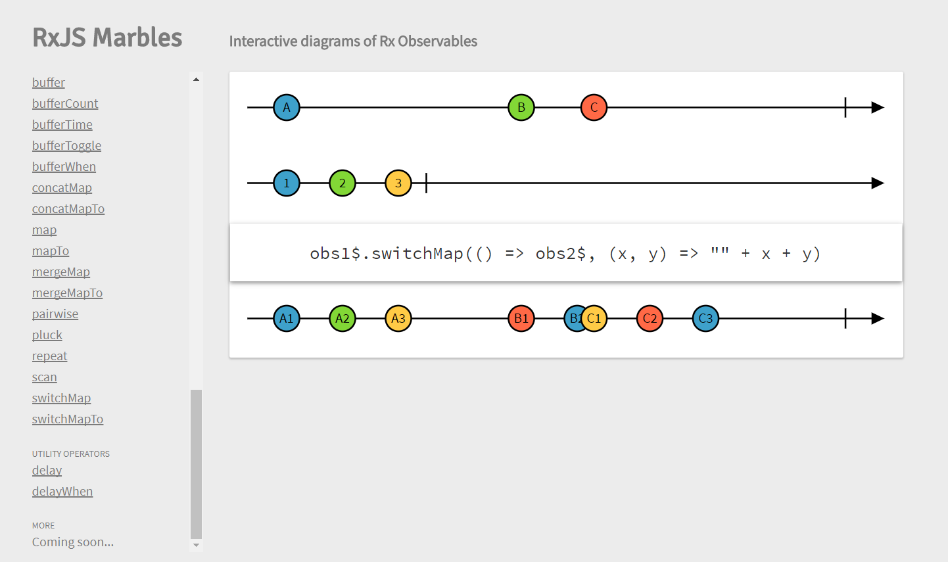
http://rxmarbles.com

Slide 46
Angular and RxJS DEMO
CACIB TECHTALK

